Slide 1

Rushmore Rocks!
Mount Rushmore National Memorial

Slide 2

Rock Cycle Video

Slide 3
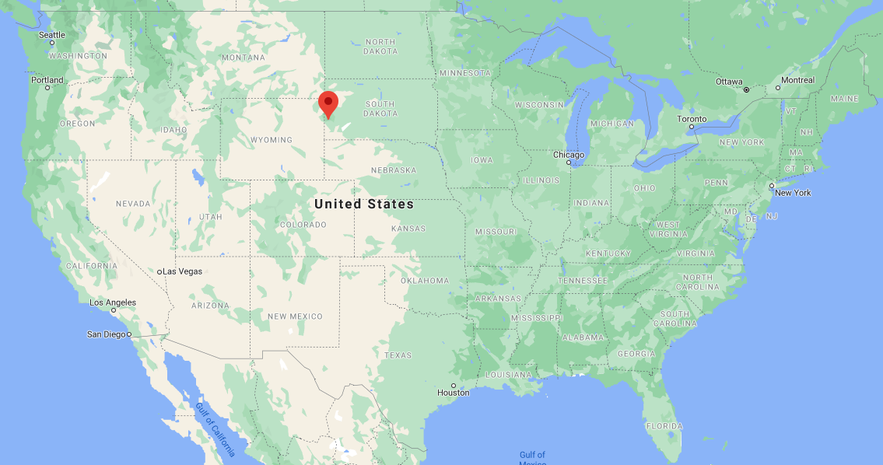
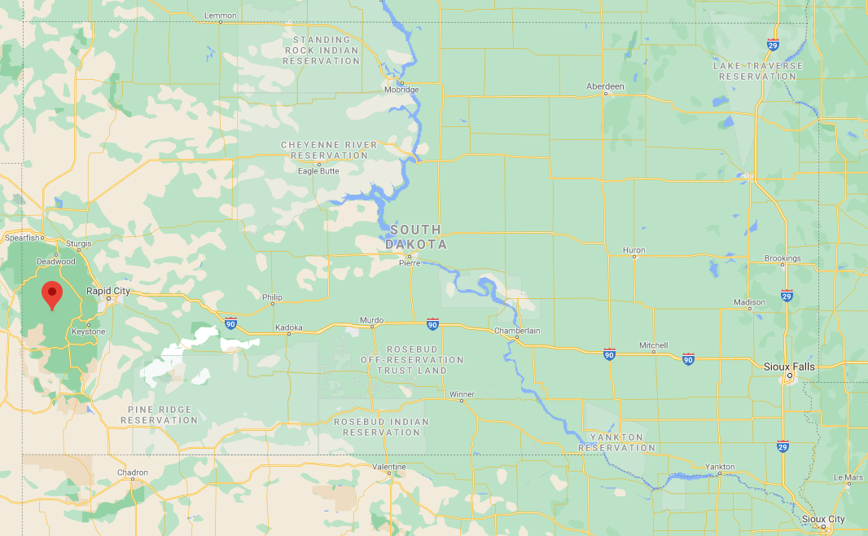
Maps of the United States and South Dakota

Slide 4
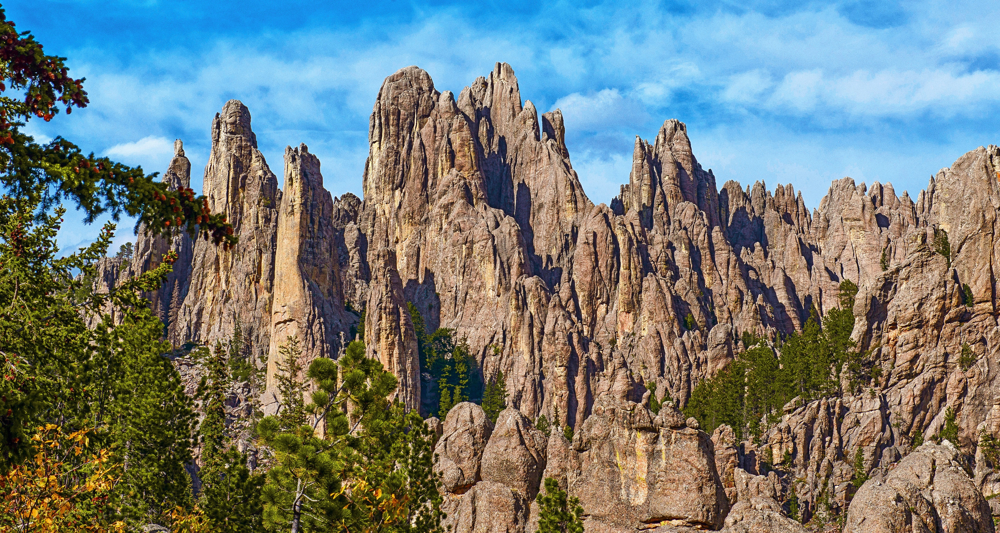
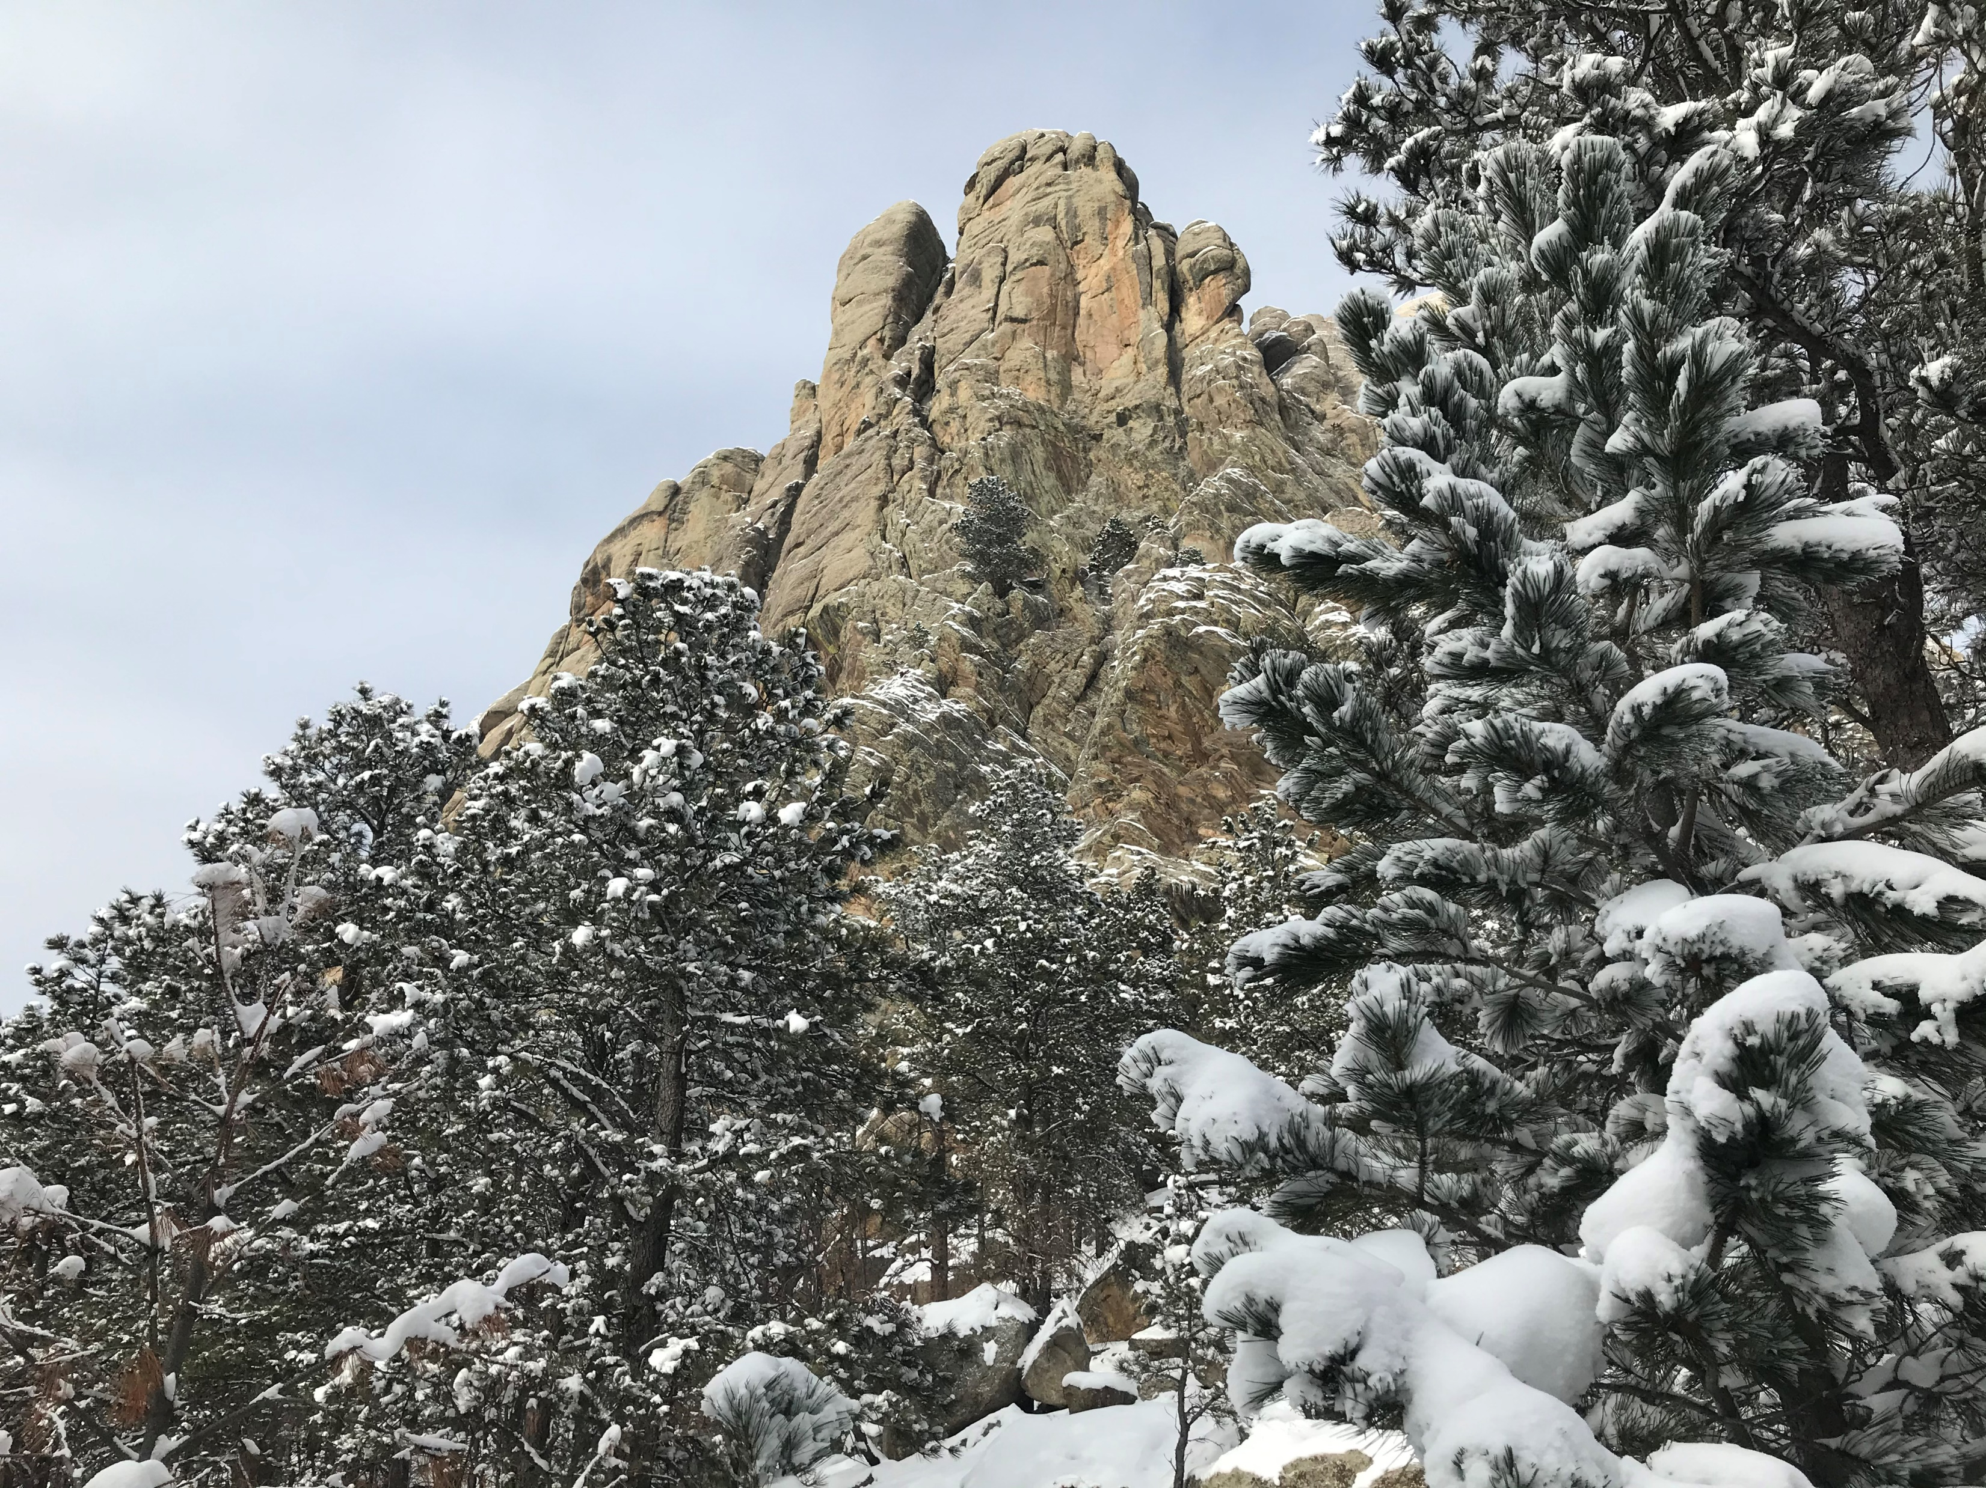
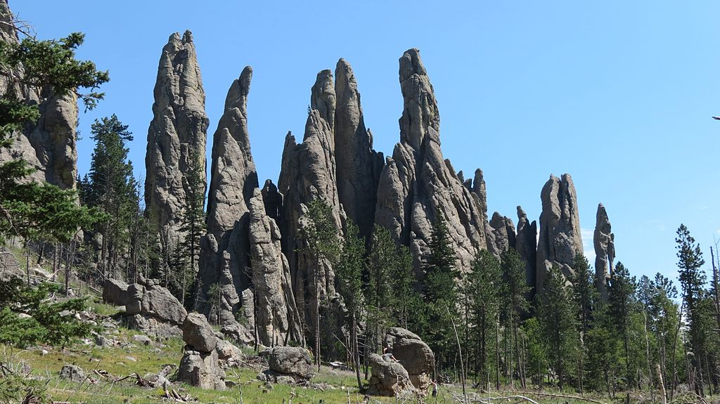
Rock Formations of the Black Hills
The Black Hills of South Dakota are unique in many ways. One is that their formation includes all three types of rocks:
Sedimentary
Igneous
Metamorphic

Slide 5
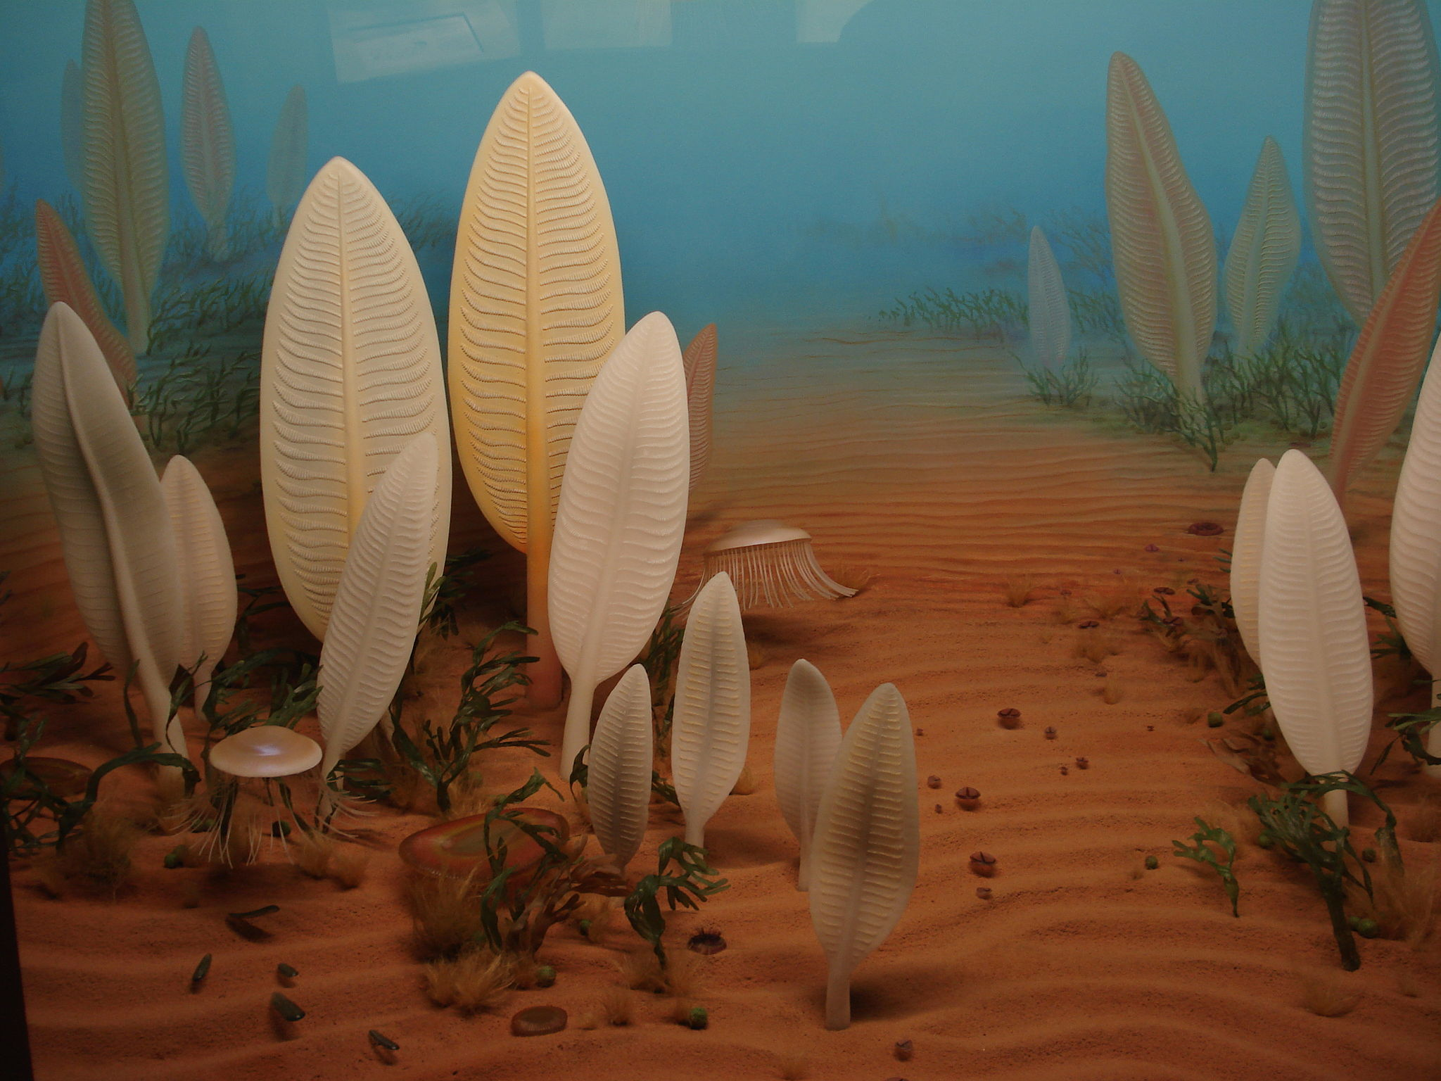
Precambrian Seafloor Illustration
What is now western South Dakota was at the edge of a shallow sea during the Precambrian period - sometime between 1.6 and 2.5 billion years ago. Over time, large amounts of sand and clay were washed down into the sea, layer after layer.
The pressure of its own weight eventually turned these many layers of sand and clay into sandstone and shale. This process is how Sedimentary Rocks are formed.

Slide 6
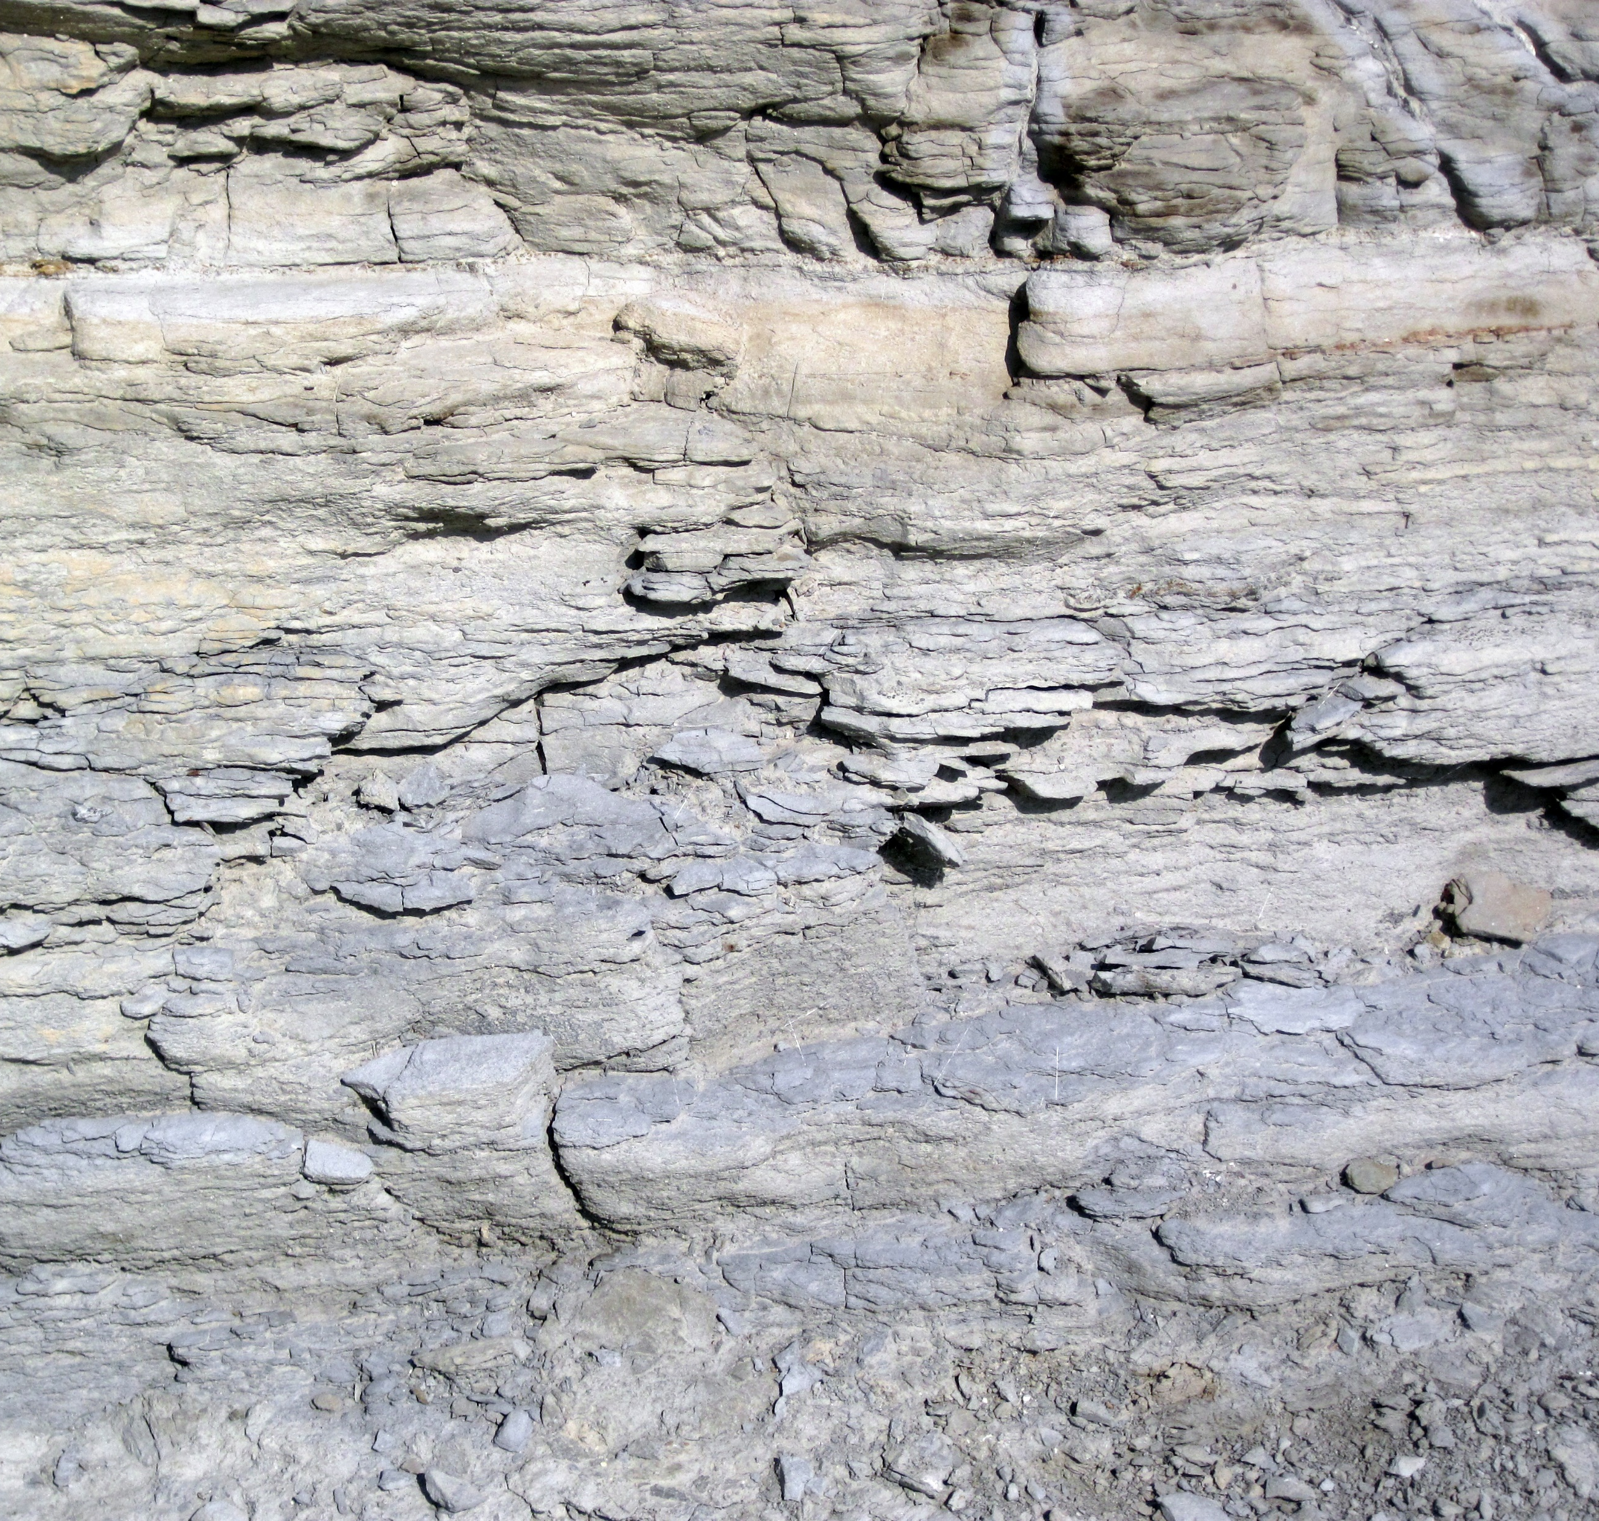
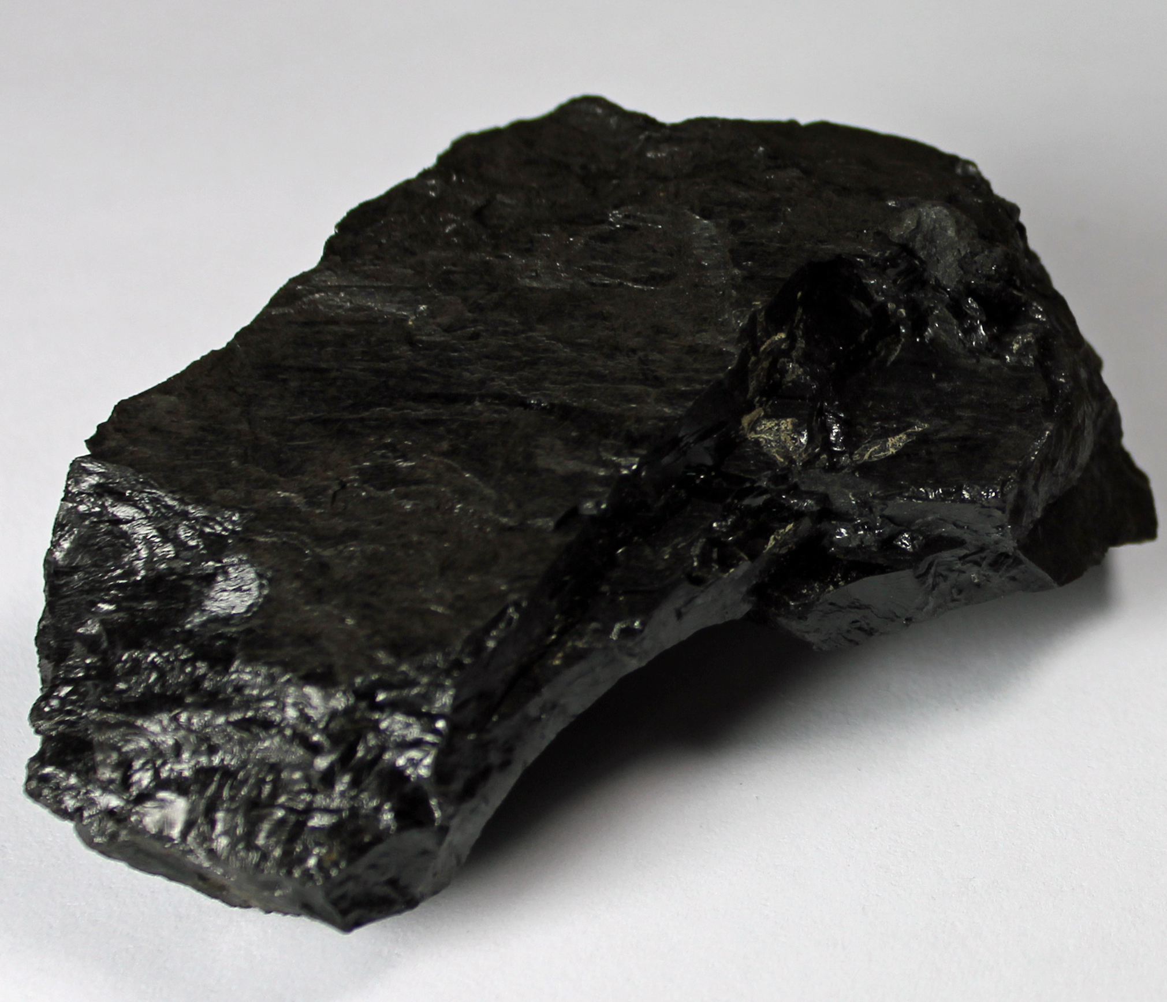
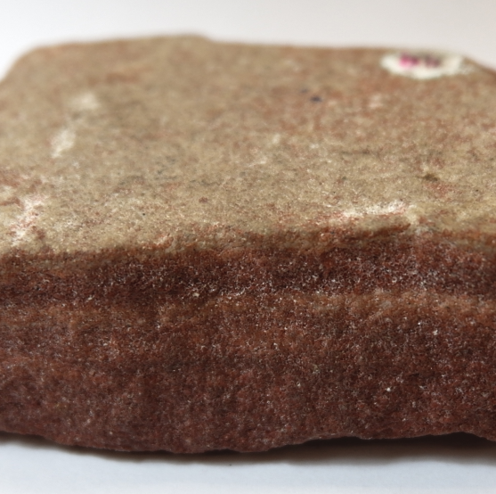
Sedimentary Rocks
Sedimentary Rocks
Sedimentary rocks are formed from pre-existing rocks or pieces of once-living organisms. They are created when many layers of these materials undergo pressure.
Sedimentary rocks often but not always:
Have smaller visible rock fragments
Are softer and erode easily
Chalk
Coal
Sandstone

Slide 7
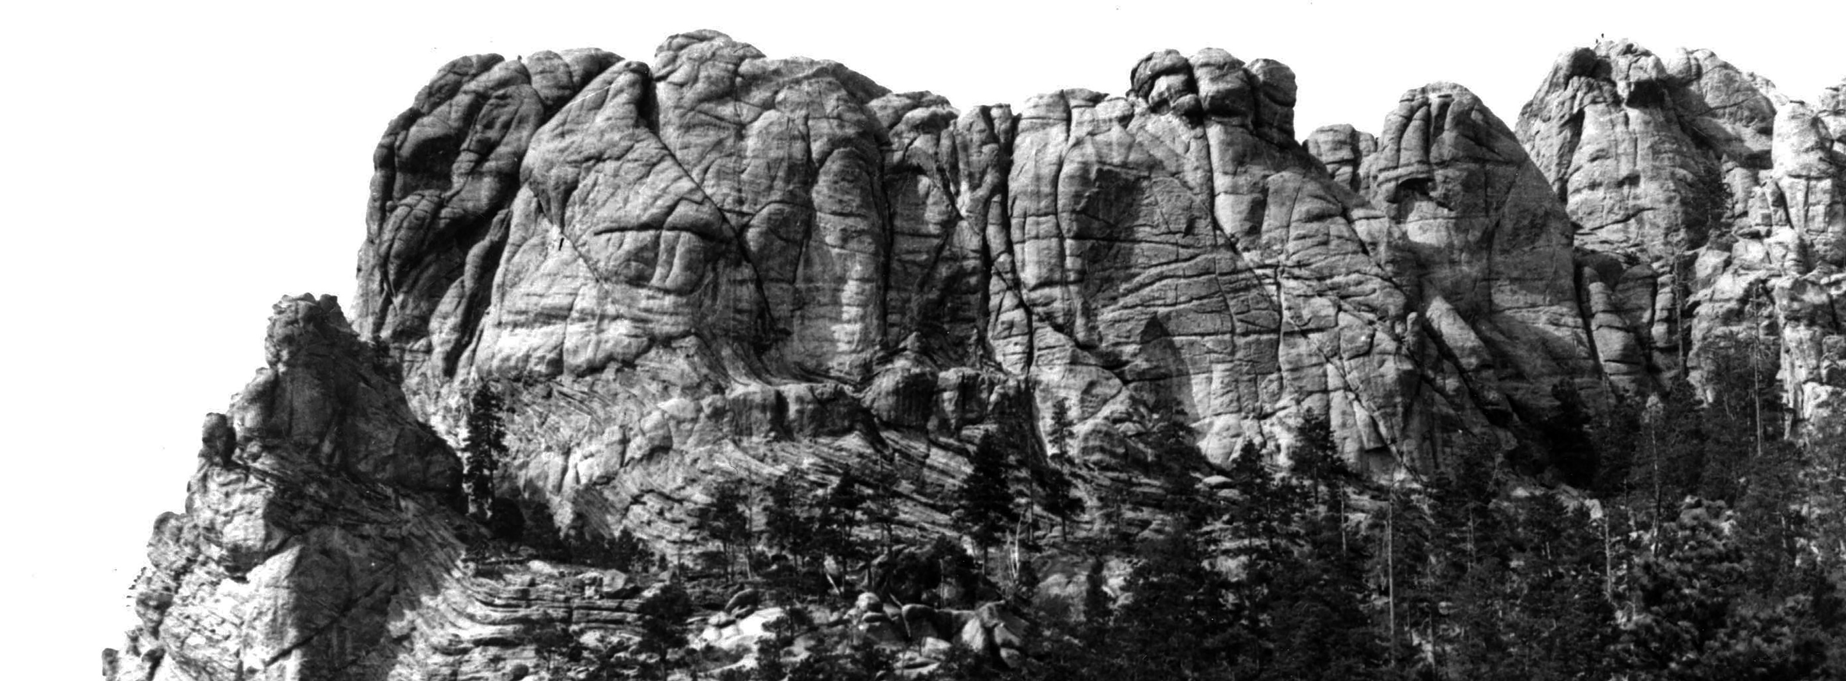
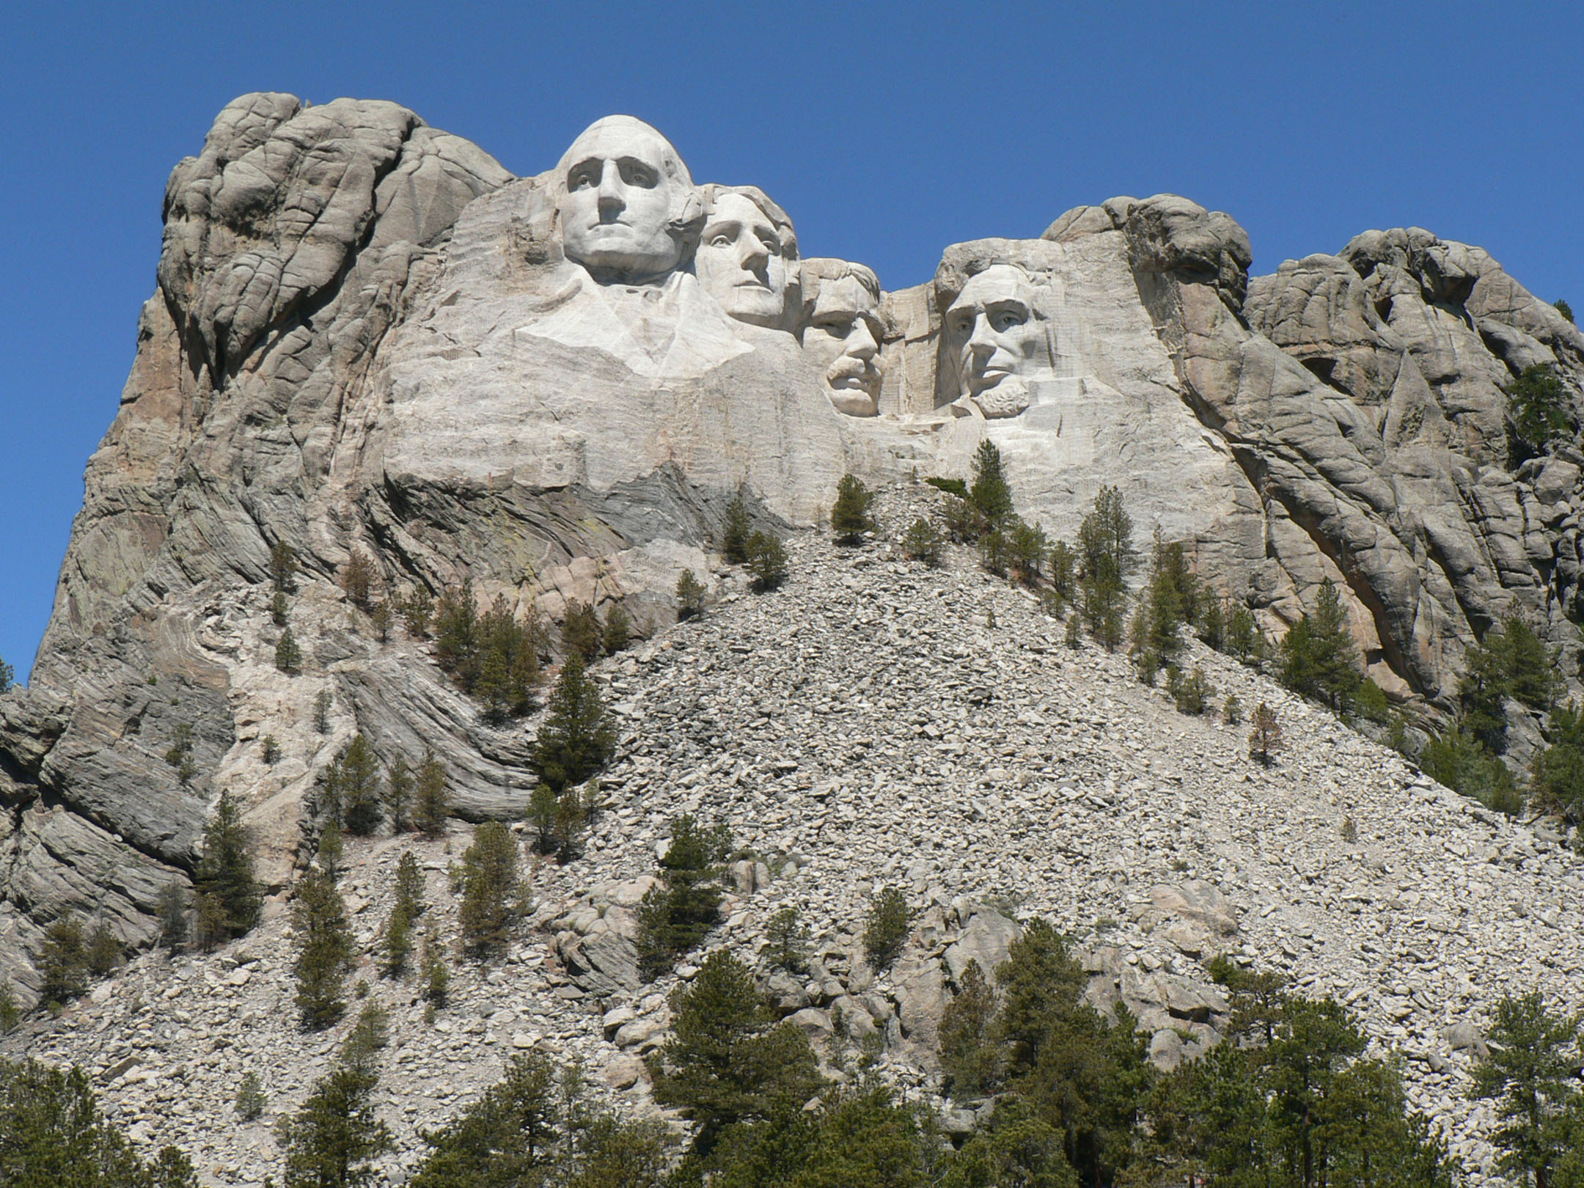
Mount Rushmore Before and After
Around the same time, 1.6 billion years ago, a great mass of molten rock began to rise from deep within the earth's crust. As this mass cooled (still underground) it formed many of the features we see around the Black Hills today.
When molten rock cools like this, it creates Igneous Rocks. A large block of granite is what forms the upper portion of Mount Rushmore.

Slide 8
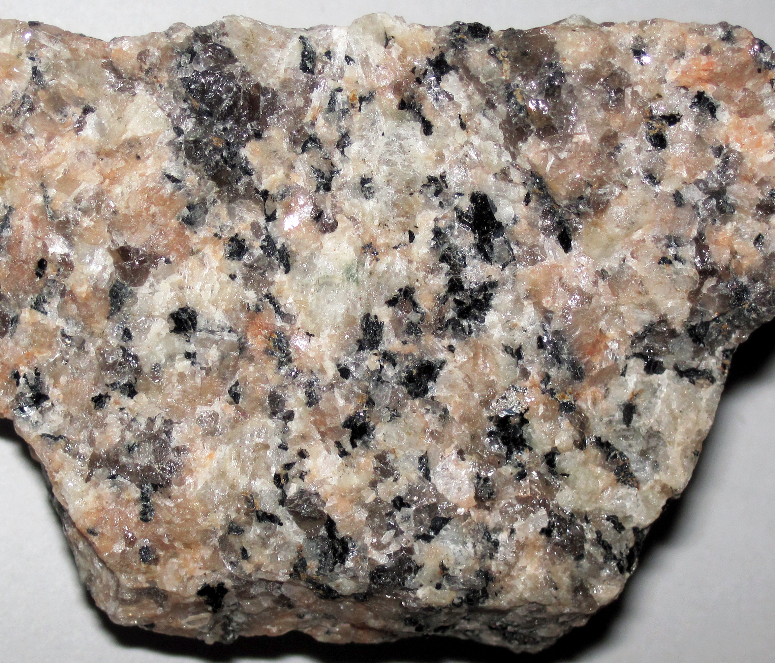
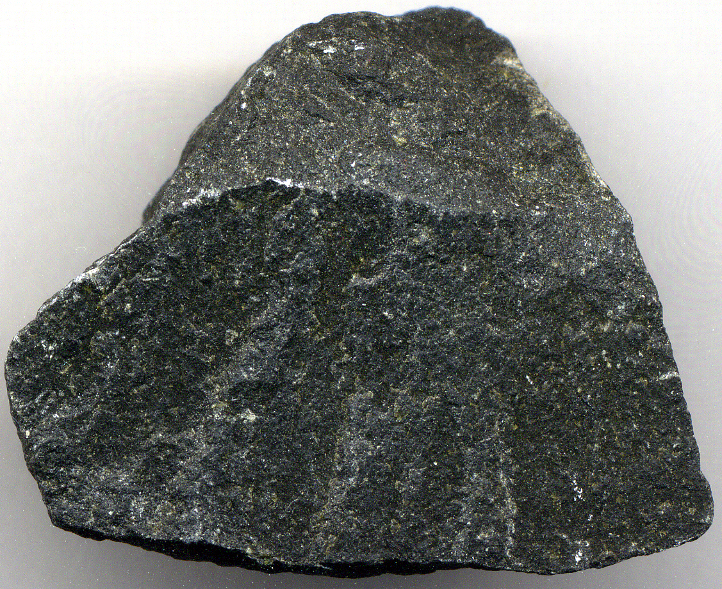
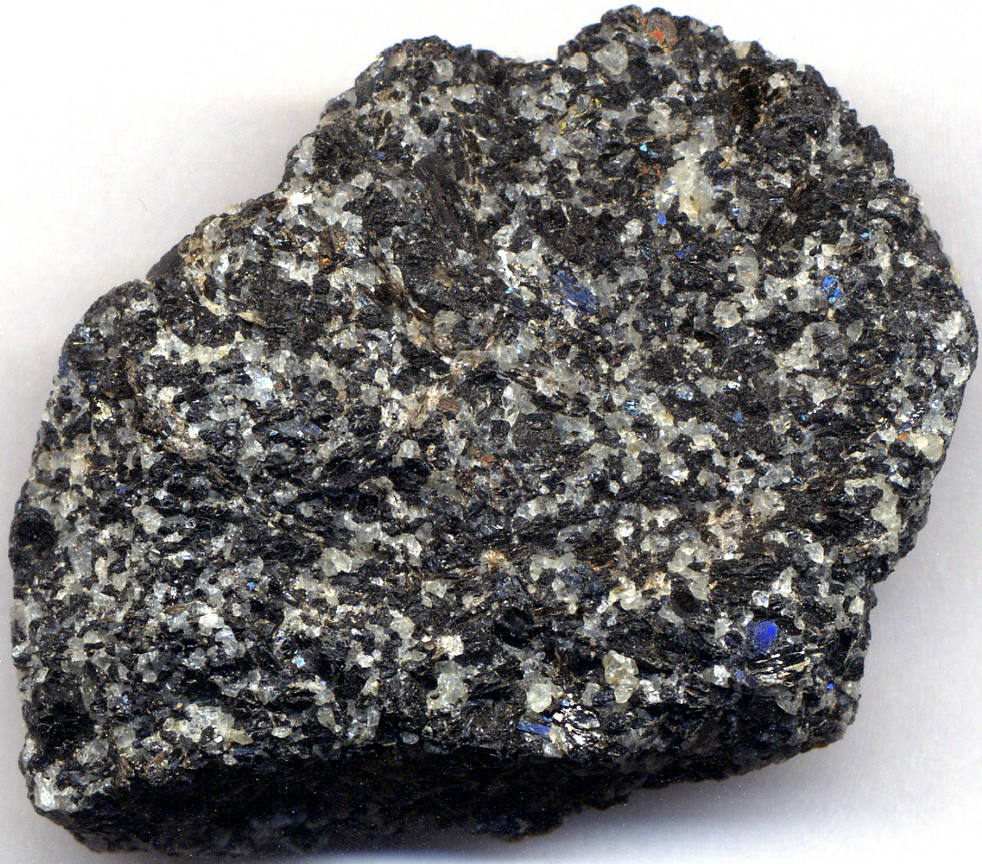
Igneous Rocks
Igneous Rocks
Igneous rocks form when hot, molten rock, called magma, hardens. This can take place inside the earth’s crust underground, or on the surface. The type of molten rock and how quickly it cools determines what kind of igneous rocks are formed.
Igneous rocks often but not always:
Have a grainy pattern or appearance
Are harder and erode slowly
Granite
Basalt
Gabbro

Slide 9
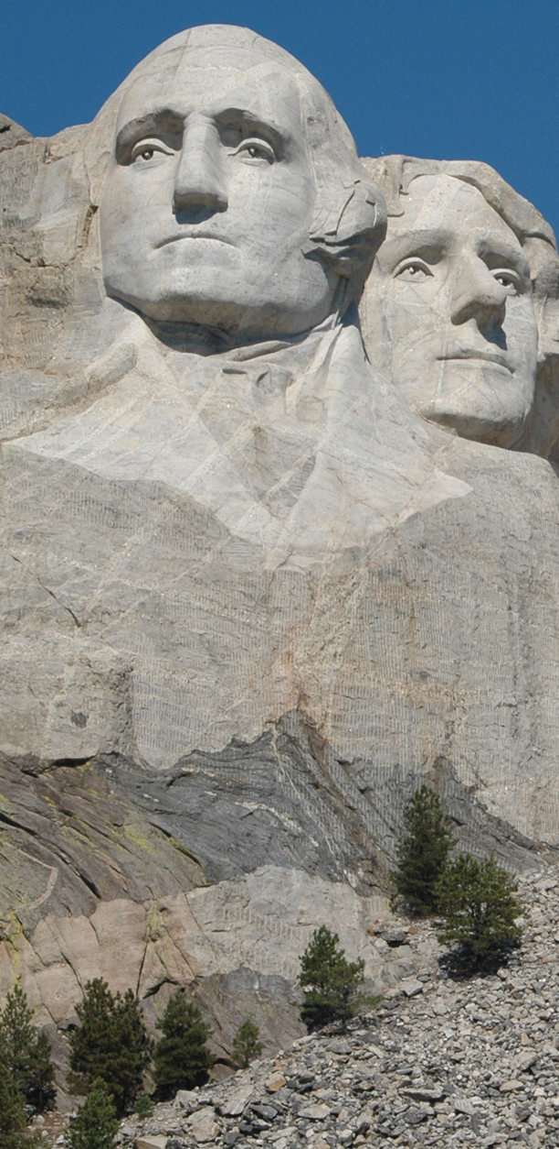
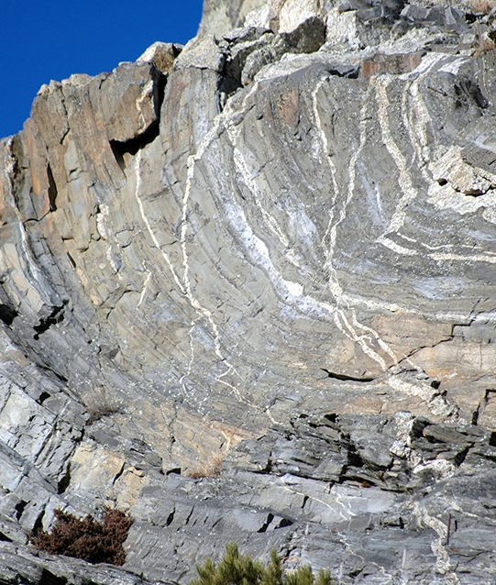
Formation of Rocks at Mount Rushmore
When molten rock rose and met the sedimentary rocks sandstone and shale, the intense heat and pressure melted changed some of the sedimentary rock into new rock. When existing rocks are changed like this, new metamorphic rocks are formed.
The shale became mica schist, which can easily be seen on Mount Rushmore under George Washington because of its dark color and pattern.

Slide 10
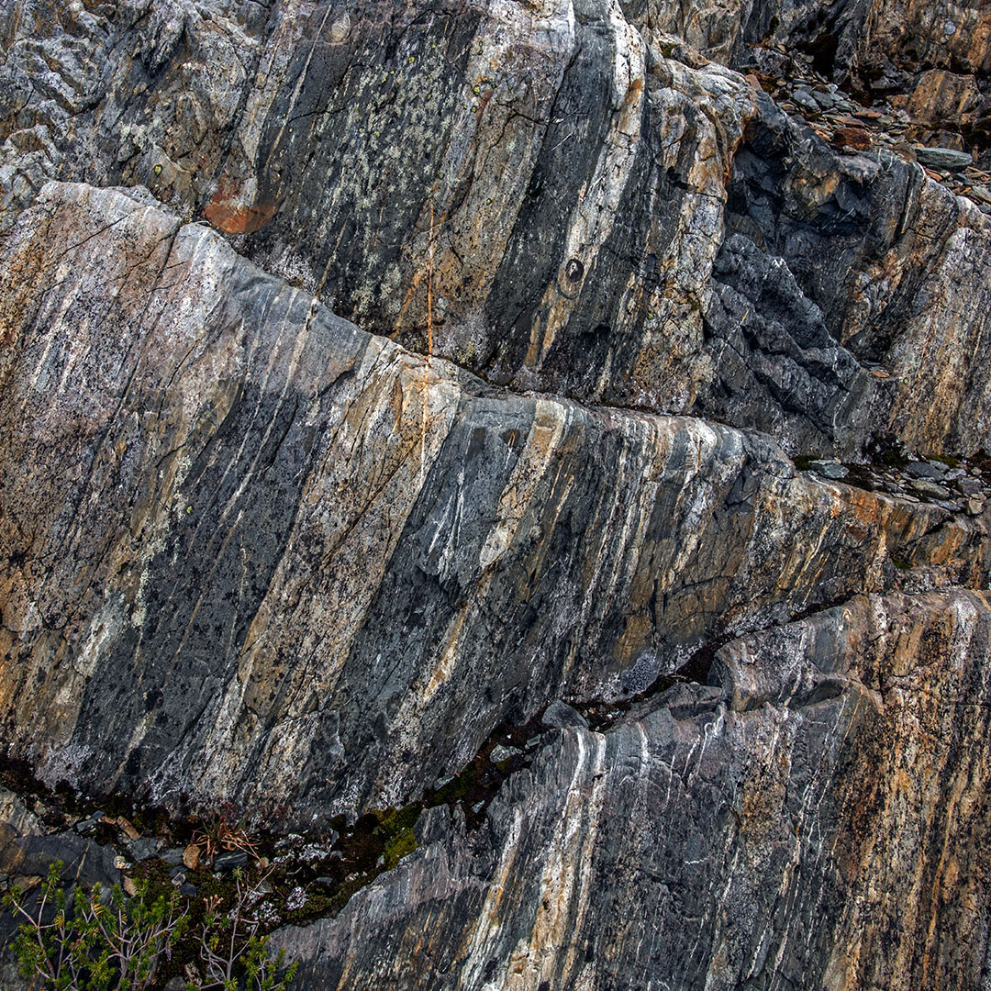
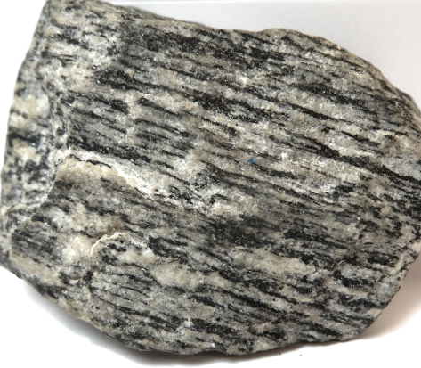
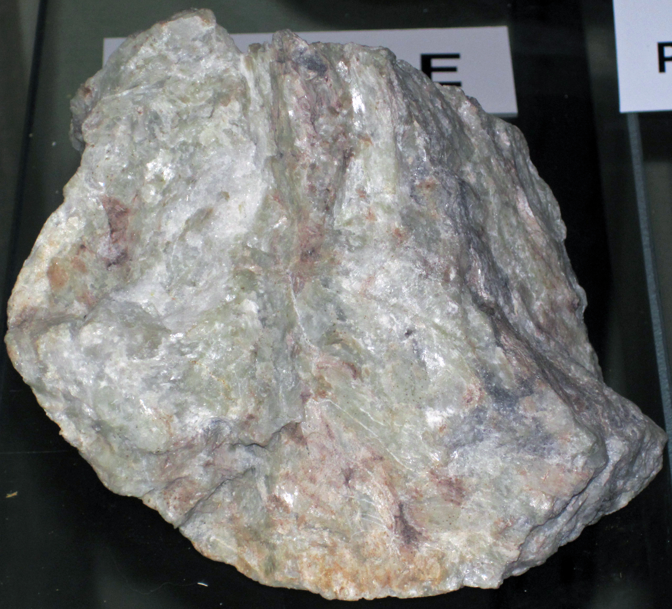
Metamorphic Rocks
Metamorphic Rocks
Metamorphic rocks form when high temperatures and pressure act on a rock to alter it. These conditions often stretch, twist, and fold the rock, leaving noticeable bands. Both sedimentary and igneous rocks can become metamorphic rocks.
Metamorphic rocks often but not always:
Have a clear stripe pattern or bands
Are harder than sedimentary rocks
Schist
Gneiss
Marble

Slide 11
Uplift of the Black Hills
As the Black Hills began to rise, the sedimentary rocks began to crack, and erode. Today we see only igneous and metamorphic rocks at Mount Rushmore and in the center of the Black Hills.
Granite, the rock Mount Rushmore is made of, erodes much slower than sedimentary rocks- only about one inch every 10,000 years!

Slide 12
Review of Rock Types
Sedimentary Rocks
Igneous Rocks
Metamorphic Rocks
Sedimentary rocks are formed from pre-existing rocks or pieces of once-living organisms. They are created when these deposits undergo pressure.
Sedimentary rocks often but not always:
Have smaller visible rock fragments
Are softer and erode easily
Examples
Igneous rocks form when hot, molten rock hardens. The type of molten rock and how quickly it cools determines what kind of
igneous rocks are formed.
Igneous rocks often but not always:
Have a grainy pattern or appearance
Are harder and erode slowly
Examples
Metamorphic rocks form when high temperatures and pressure act on a rock to alter it. These conditions often stretch, twist, and fold the rock.
Metamorphic rocks often but not always:
Have a clear stripe pattern or bands
Are harder than sedimentary rocks
Examples
Chalk
Coal
Sandstone
Granite
Basalt
Gabbro
Schist
Gneiss
Marble

